Slide 1


DRIVING ENGAGEMENT FOR SOCIAL BUZZ

Slide 2


Today's agenda
Project recap
Problem
The Analytics team
Process
Insights
Summary

Slide 3

Social buzz a social media and content creation platform
Founded in the year 2010 and headquartered at San Francisco.
We will be running a 3 month initial project with the company , social buzz, which includes:
A audit for their big data practise.
Recommendation for successful IPO.
Analysis of content categories.
Project Recap

Slide 4

PROBLEM
Scaled quickly than anticipated about 500 million users /month
A large amount (~100,000) of unstructured data being generated and managing which is becoming a concern.
Analyse the data and identity which categories drive the major user engagement for a effective scaling process ?

Slide 5


Andhrew fleming
Chief technical architect
The Analytics team
Marcus rhompton
Senior principle
Jaswanthi
Data analyst

Slide 6
Process
1
Definning the objective of the analysis
data cleaning
data modelling
data visualization
unveiling insights
2
3
4
5

Slide 7

Insights

Slide 8
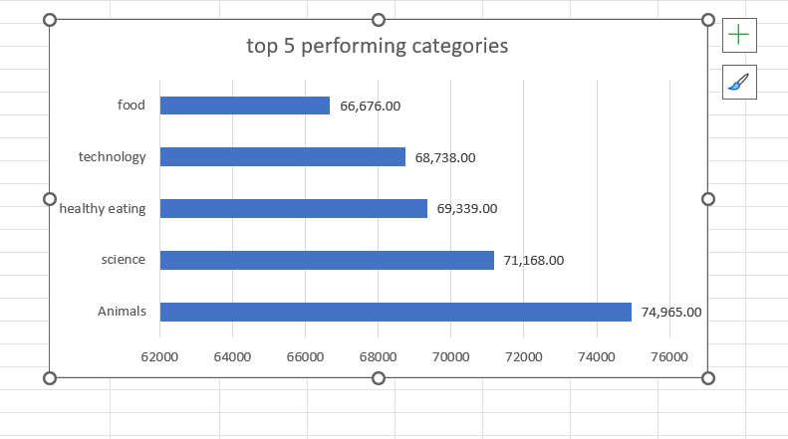
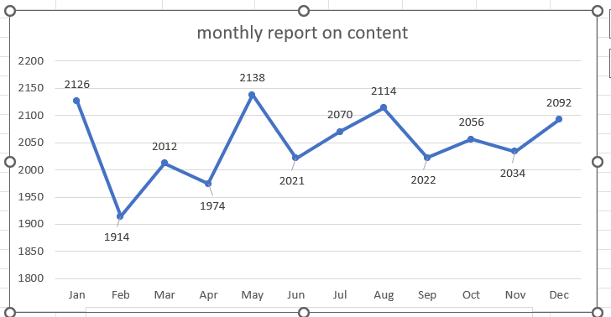
The category animals , followed by science and healthy eating are highly performing categories.
There is inconsistency in posting content on the platform , the year starting with 2126 posts by in the following month it fell to 1914 posts.

Slide 9
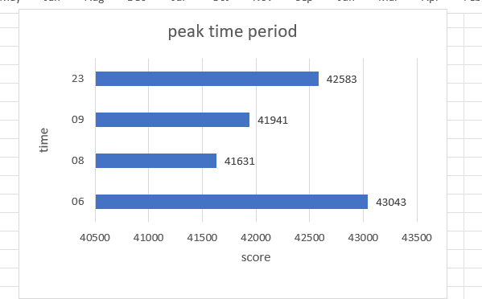
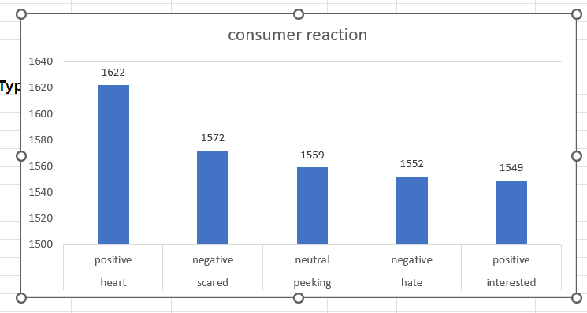
The peak time for posting content on the platform is around 6 in the morning .
The positive reaction with heart reaction is the highest around 1622 reaction , followed by negative reaction that is scared reaction. It can be said that large part of the reactions are of negative and neutral.

Slide 10
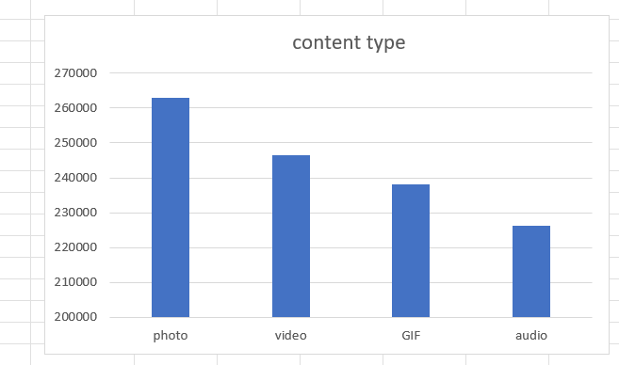
Photos followed by videos drive most of the audience .

Slide 11

More focus should be given for creating content on animals , science and healthy eating as such type of content perform well
The platform should be consistent in posting content as it helps to retain existing viewers.
Content should be posted in peak hours around 6 to reach larger audience .
Try to create positive content and consider consumer feedback to create content that audience prefer the most
Content in the form of pictures and videos should be posted to increase the enagement
Summary

Slide 12
Thank you!
ANY QUESTIONS?

